Slide 1
Chapter 1
An Introduction to Crime Scene Investigation

Slide 2
Learning Objectives
Understand the definition of crime scene investigation
Understand the objectives of CSI
Understand the types of evidence
Understand the value of physical evidence
Define the scientific crime method
Know how to establish a proper chain of custody

Slide 3
Common Terminology
Investigate: make a systematic examination or to conduct an official inquiry
Crime: act or commission of an act that is forbidden by a public law and that makes the offender liable tp punishment by that law
Crime Scene Investigation (CSI): process associated with the investigation of a criminal event, which involves a systematic process of documenting, collecting, preserving and interpreting physical evidence.

Slide 4
Common Terminology (continued)
Trier of fact: the determination of guilt or innocence left up to the judge/magistrate or jury of peers
Criminalistics: the analysis of physical evidence
Important to note that criminalistics and CSI are not the same

Slide 5
Who is Responsible?
The first tier of the investigation process is the first responder
First responder: typically the police officer who is dispatched to the initial scene
The duty of the first responder is to secure the scene and begin securing and preserving the physical evidence

Slide 6
Who is Responsible? (continued)
The second tier of the investigation process is the detective/investigator
This is a specialized police officer with significant experience in investigations
The detective process information given to him/her and determines if there needs to be any additional investigation. He/she will also collect testimonial evidence

Slide 7
Who is Responsible? (continued)
The third tier of the investigation process is the crime scene investigator/crime scene technician
The CSI has advanced training in documentation, collection, and preservation of physical evidence
The CSI processes the scene and transports the evidence into booking

Slide 8
Who is Responsible? (continued)
The fourth tier involved in the investigation process is the criminalist
Responsibilities of the criminalist include: analyze and interpret the evidence using the latest scientific instrumentation
The courts are considered the fifth tier of the investigation process
This process involves the prosecution, defense, judge/magistrate and jury in determining if enough evidence was presented to show that a crime was committed

Slide 9
Objectives of Crime Scene Investigation
Determine whether a crime has been committed
Discovery and documentation of all facts
Identify and eliminate suspects by collecting physical and testimonial evidence
Locate and apprehend the perpetrator
Maintain a proper chain of custody
Effectively testify as a witness

Slide 10
What is a Crime Scene?
Crime Scene: anywhere that evidence may be located that will help explain the events; location at which the crime was committed
Primary scene: the first scene where evidence is located
Secondary scene: any subsequent scenes to the primary
Every crime scene is unique and dynamic

Slide 11
Types of Evidence
Testimonial evidence: vocal statements that most commonly are made by a person who is under oath
Examples: witness statements, victim statements, & spontaneous utterance by suspects
It is important to note that all testimonial evidence is considered to be a lie until corroborated by other physical evidence or testimonial evidence
Real or physical evidence: any type of evidence with an objective existence, that is, anything with size, shape and dimension

Slide 12
Types of Evidence (continued)
Examples: Gases, fingerprints, glass, paint, hair, blood, soil and drugs
Direct evidence: proves a fact without the necessity of an inference or a presumption
Circumstantial evidence: involves a series of facts, that although not the fact at issue, tend, through inference, to prove a fact at issue
Direct or circumstantial evidence can be involved with either testimonial or physical evidence

Slide 13
Value of Physical Evidence
It can prove that a crime has been committed or establish key elements of a crime
It can establish the identity of persons associated with the crime
It can place the suspect in contact with the victim or with the crime scene
It can exonerate the innocent
It can corroborate the victims testimony
Court decisions have made physical evidence more important
Juries expect physical evidence

Slide 14
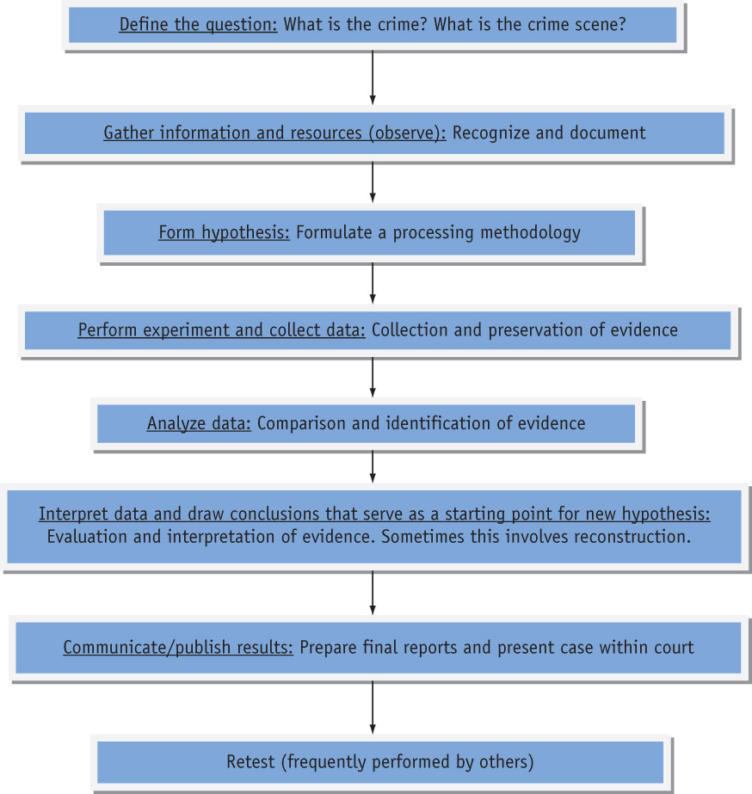
Scientific Crime Scene Investigation
Figure 1-3 The Scientific Investigation Method

Slide 15
Collection and Preservation of Physical Evidence
If the evidence is found to be illegally collected then it will be inadmissible in court. (Fruit of the Poisonous Tree Doctrine)
All evidence must be collected, handled and stored in a way that will ensure its integrity.
Items should be packaged separately
Known or control samples are needed
Paper is preferred packaging material
Sealable/airtight containers are necessary
Avoid contamination

Slide 16
What and How Much to Collect?
A crime scene investigator must ensure that all necessary evidence has been collected. “More is better than less”
Crime scene personnel should consider the proper collection method that will ensure the proper amount of evidence has been collected, which will result in the least amount of storage-related issues
Example: king sized mattress at a homicide scene

Slide 17
Chain of Custody
Chain of custody: shows who had contact with the evidence, at what time, under what circumstances, and what changes
What is needed to establish a chain of custody?
Name/initials of the individual collecting the evidence
Dates the item was collected and transferred
Agency, case number, and type of crime
Brief description of the item
Evidence must be properly booked and stored as well

Slide 18
Teamwork
Successful CSI involves a team approach
Crime scene team: group of professionals, each trained in specific disciplines
The common goal of the team is to locate and document all of the associated evidence at the scene
Teamwork is important because no one person can operate independently at a crime scene
Training for each member is mandatory
A successful investigation includes a well-trained, experienced and cohesive unit

Slide 19
Attributes of a Successful Crime Scene Investigator
Intuition
Eye for detail
Good communication skills
Knowledge of methods for location and preserving evidence
Enjoyment of continuing education

Slide 20
Mistakes and Errors
Mistakes will be made, but need to be limited
Learn from these mistakes and do not repeat them
It is important to adopt a systematic approach to crime scene processing to help minimize errors
Defense attorneys will do what they can to show that the initial handling of physical evidence was faulty
The best thing to do is consider all ramifications before embarking on any action

Slide 21
Chapter 2
The CSI Effect

Slide 22
Learning Objectives
Understand the “CSI effect”
Know how to overcome the CSI effect

Slide 23
Birth of a problem
1950’s: Perry Mason (U.S. court systems)
1976-1983: Quincy of M.E. (forensic pathology)
2000’s: CSI (physical evidence)
CSI aired on October 6, 2000
Forensic Files aired in October 2001
CSI is currently the most influential TV show in the world and portrays “infotainment”
Infotainment: a highly stylized, edited and formatted form of entertainment that is disguised as informative or realistic, but in fact is not scientifically correct

Slide 24
The CSI Effect
CSI effect: phenomenon whereby forensic drama television has created unreasonable expectations in many areas of forensic science
CSI programs lead to a singular correct answer
Reality: Forensic conclusions are only as good as the technicians who retrieve the evidence, test it, and draw conclusions from it
CSI programs show no concerns of human error
Reality: Numerous professionals have lied under oath, faked their credentials and fabricated evidence

Slide 25
Impact of the CSI Effect
Population believes TV shows are realistic
Prosecutors say that juries expect scientific evidence in every case
In reality, not all criminal cases call for such evidence
Defense uses this to their advantage, they suggest that fingerprints or DNA should have been presented, creating controversy that it was an incomplete investigation

Slide 26
Impact of CSI Effect (continued)
CSI effect has some positive impacts, including: an increase in the publics awareness of forensics, and increased funding resources
It has also created a profound interest in forensic science and crime scene work
Jurors have a better knowledge of what a crime scene technician does, and are able to understand and follow expert witness testimony better

Slide 27
Impact on Law Enforcement
Police departments and crime labs have spent much of their annual budgets to acquire modern technology and training
Thousands of dollars being spent on DNA technology or trace evidence collection
Fingerprint or footwear evidence is being overlooked
Departments believe they need to improve their forensic capabilities
There is more collection and booking of evidence

Slide 28
Impact on Crime Labs
Quantity of evidence being sent to the labs is increasing at an enormous rate
Police expect miracles from crime labs
Police are now sending more samples to be analyzed
As samples increase, so does the backlog of the crime lab
For example, in the crime lab in Westchester, NY, handles nearly 1,000 DNA tests, which is up from 400 just five years ago

Slide 29
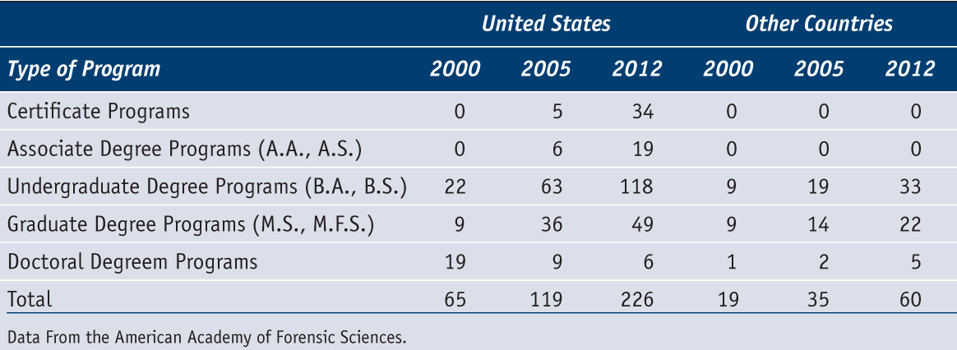
The CSI Effect on Education (continued)
Table 2-1 Comparison of the Growth of Forensic Science–Related Programs in the United States and Other Countries

Slide 30
Influence on the Criminal Mind
The CSI effect may be altering how crimes are committed
Increases in criminal cases in which suspects burn or tamper with evidence
Ex: using bleach to destroy DNA evidence in attempt to carefully clean the crime scene of trace evidence
Certain viewers use these shows as a training ground on how to cover up their own tracks
Case example: Jermaine “Maniac” McKinney, Ohio

Slide 31
Overcoming the CSI Myths
Myth: crime labs do not lie
Reality: there are sample degrades, tests are inconclusive, and lab technicians make mistakes
Myth: some of the science is state-of-the-art and can only be performed by real lab technicians
Reality: many techniques on the shows do not exist conceptually, meaning they have not been invented
One forensic scientist estimates that 40% of the so-called “science” on CSI does not exist

Slide 32
Overcoming the CSI Myths
Crimes do not take an hour to solve, especially homicides
Myth: a forensic scientist is a combination of a police officer, crime investigator, and forensic scientist
Reality: different professionals fulfill each role
Should crime drama shows issue a type of warning at the beginning of each episode, stating that some of the technology used in the program is fictional?

Slide 33
Chapter 3
Ethics in Crime Scene Investigation

Slide 34
Learning Objectives
Define and apply ethics in crime scene investigation
Understand the ethical concerns governing retention and disposition of crime scene artifact
Define and distinguish between an expert witness and a lay witness
Understand and research unethical practices involving crime scene work and forensic analysis

Slide 35
What are Ethics?
A crime scene investigator must not only do technical things correctly, they must do ethically correct things
Ethics: the study of moral standards and how they affect conduct
Greek word ethos: emphasizes the perfection of the individual and the community in which he or she is defined
Ethics are usually codified by a group of people or organization
Ethics are internally defined and self-imposed

Slide 36
What are Ethics? (continued)
Do not confuse ethics with values or morals
Values: beliefs of an individual or group, for or against something in which there is some emotional investment
Typically values are the rules by which an individual or group makes decisions as to what is right or next
Morals: relate to how individuals should behave, but can be determined from personal conscience and/or common standards of justice to do good

Slide 37
Revisiting the Basics
Ethics is about right and wrong
Ethics is about virtue and vice
Ethics is about benefit and harm
Ethics is simply about the “fixed, universal rules of right conduct that are contingent on neither time nor culture nor circumstance
Ethics is also about character, “the traits, qualities, and established reputation that define who one is and what one stands for in the eyes of others”
Lastly, it is “an established pattern of conduct worthy of emulation

Slide 38
Ethics Involves What?
Ethics is the way values are practiced
It is both a process of inquiry (deciding how to decide) and a code of conduct
Code of conduct: a set of standards governing behavior
Critical thinking: the conscious use of reason
When dealing with ethics, “the well-being of someone or something beyond ourselves is always at stake”

Slide 39
The Road to Unethical Behavior
“Traversing down the slippery slope”
Ways to minimize the instances of corruption are included in five steps for any department
Ensure thorough background investigations of all employees
Ensure a high-quality field training program for new crime scene investigators
Ensure consistent and fair accountability for employee actions
Conduct effective ethics training
Implement an effective employee intervention process

Slide 40
Ethics in Crime Scene Investigation
Majority of forensic specialists realize that is its illegal to remove objects from a crime scene without proper authorization
Crime scene investigators and officers must maintain the spirit of the law as well as the letter of the law
Guidelines are necessary
Example: removing or selling artifacts from a crime scene
Education, training, experience, skills and opinions on technical matters are of considerable importance during a criminal investigation
Crime scene personnel may never be biased

Slide 41
Ethics in Crime Scene Investigation (continued)
Their obligation is to serve the aims of justice
Forensic personnel have an obligation not to overstate, or understate scientific findings
Some departments have implemented the code of ethics that all employees must sign and adhere by
The obligation to be truthful is paramount above all else
Acts of commission (intentional) and omission (unintentional) are not permitted
Crime scene investigators must remain neutral and preserve the chain of custody

Slide 42
Expert Witnesses
Expert witness: someone who is often called to answer questions on the stand in the court of law in order to provide specialized information relevant to the case being tried
A person can be considered an “expert” when they have sufficient skills, knowledge, or experience
The duty of the expert witness is to educate the jury and provide testimony using terminology that is easily explainable and not misunderstood
Some essential elements of an expert witness include: clarity, simplicity, and honesty

Slide 43
Qualifying an Expert Witness
Credentials: this refers to a certificate, letter, experience, or anything that provides authentication for a claim or qualifies somebody to do something
Hearsay: unfounded information that is heard from other people
Perjury: telling of a lie within a court of law by somebody who has taken an oath to tell the truth

